Slide 1
Simplifying Objects and Inheritance in JavaScript
Dhananjay Kumar
@debug_mode
http://debugmode.net

Slide 2
Important points
Tweet your experience about webinar using the hashtag #Infragistics or tag @infragistics to win cool goodies from us.
Recording of webinar will be available by Wednesday on Infragistics blog.
You will also get Email notification for uploaded recording
We welcome all of you to take advantage of a FREE 30 Day Trial by downloading the product at: http://www.infragistics.com/products/ultimate/download
Please reach out to us at Sales-India@infragistics.com for any follow up questions you may have. We welcome the opportunity to assist you.

Slide 3
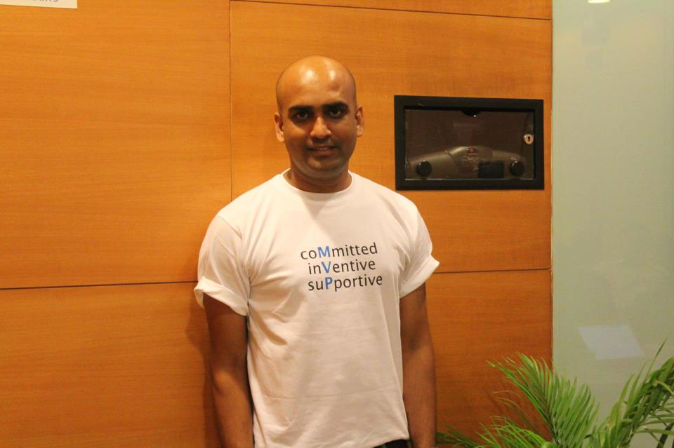
I am Dhananjay Kumar
Infragistics Developer Evangelist
6 times Microsoft MVP
@debug_mode
dkumar@infragistics.com
http://debugmode.net

Slide 4
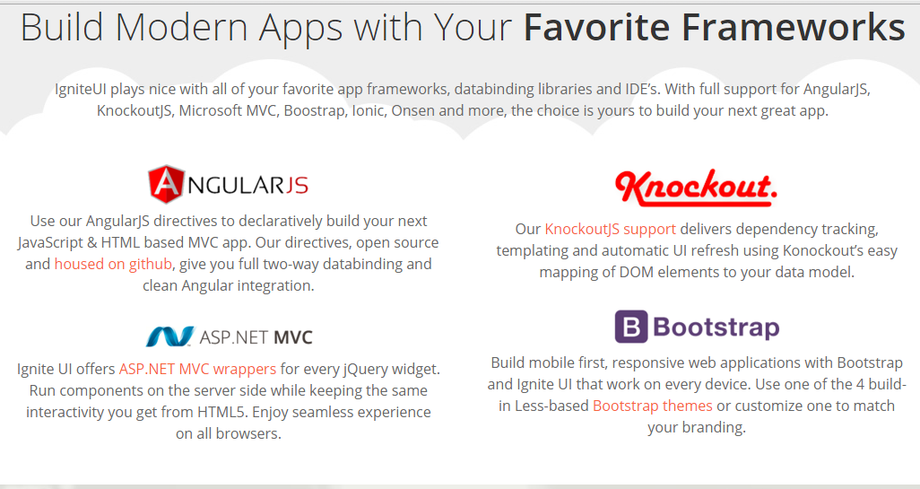
Ignite UI = ig jQuery library
http://www.igniteui.com

Slide 5
Agenda
Object literal
Function constructor
Revealing pattern
Understanding value of “this”
__proto__ property of object
Prototype value of function
Inheritance using __proto__ and prototype
Object.create() method for object construction
Creating inheritance chain

Slide 6
Running JavaScript
I am using Sublime Text to write JavaScript
Running JavaScript using NodeJS
Pressing CTRL+B to run JavaScript and see the output in sublime
http://debugmode.net/2013/11/07/how-to-setup-javascript-build-in-sublime-text-2/

Slide 7

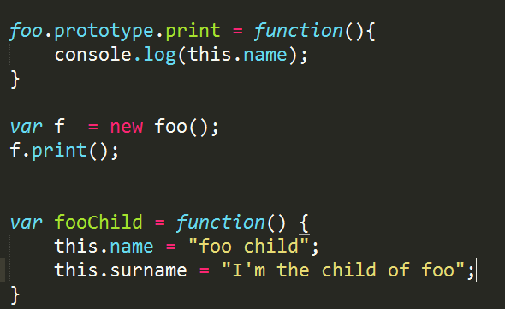
We are going to write more codes and less PPT

Slide 8
Object in JavaScript
Object
Object.create
Object as literal
Function constructor

Slide 9
Object properties
Properties can be added to an object at any time. A property can be added to an object after its creation too.
In the object’s method, current object is defined by value “this”.
Other object can also be passed as value of “this”.
Calling a function as method is known as “Method Invocation Pattern”.

Slide 10
Prototype of function
Every function has a prototype property
A function prototype is the object instance which eventually becomes prototype of all the objects created using that function constructor
Object does not have prototype property
Function prototype value is an object instance which will become prototype of all the objects created using this function as constructor.

Slide 11
__proto__ of object
Every object has a __proto__ property
Object __proto__ value is set to the object instance from which object is inherited
__proto__ is used for object inheritance
Function does not have __proto__ property
Object __proto__ is object instance from which the object is inherited.

Slide 12
__proto__ based inheritance
JavaScript supports prototype based inheritance
In JavaScript objects inherit each other.
Parent object is also known as prototype of child object in JavaScript.
In JavaScript inheritance is implemented through (for objects) special property __proto__
To access a property, JavaScript first searches objects, if it does not find it, it searches that in __proto__ property of object. In modern browser __proto__ property is also known as prototype property.

Slide 13
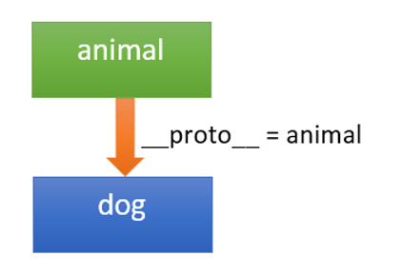
JavaScript inheritance
Very first it searches property in the current object. If it finds it, it uses it.
If it does not find property in the current object, it searches the property in the __proto__ values of the object. It traverse in the tree until __proto__ value becomes null.
Value of “this” is always set to current object regardless the value of __proto__ or prototype

Slide 14
Q& A ?

Slide 15
Summary
Object literal
Function constructor
Revealing pattern
Understanding value of “this”
__proto__ property of object
Prototype value of function
Inheritance using __proto__ and prototype
Object.create() method for object construction
Creating inheritance chain

Slide 16
What Infragistics can offer you?
We welcome all of you to take advantage of a FREE 30 Day Trial by downloading the product at: http://www.infragistics.com/products/ultimate/download
Please reach out to us at Sales-India@infragistics.com for any follow up questions you may have. We welcome the opportunity to assist you.
For technical queries send me email at dkumar@infragistics.com

